Slide 1
Composition, Inheritance and Virtual Functions

Slide 2
Inheritance and Composition
The two common ways to relate two classes in a meaningful way are:
Inheritance (“is-a” relationship)
Composition (“has-a” relationship)

Slide 3
5.5 Composition (objects inside the objects)

Slide 4
Composition
In composition, one or more member(s) of a class are objects of another class type
Composition is a “has-a” relation
Arguments to the constructor of a member-object are specified in the heading part of the definition of the constructor

Slide 5
5.5.7 Objects inside objects (1)
class Element {
int value;
public:
int Get(void) { return value; }
void Put(int val) { value = val; }
};
class Collection {
Element el1, el2;
public:
int Get(int elno) { return elno == 1 ? el1.Get() : el2.Get(); }
int Put(int elno, int val) { if(elno == 1) el1.Put(val); else el2.Put(val); }
};
int main(void) {
Collection coll;
for(int i = 1; i <= 2; i++)
coll.Put(i, i + 1);
for(int i = 1; i <= 2; i++)
cout << "Element #" << i << " = " << coll.Get(i) << endl;
return 0;
}

Slide 6
5.5.7 Objects inside objects (1)
An object of any class may be the field of an object of any other class.
All rules concerning access to class components are honoured in this case too.
There’s a very simple class named Element.
It’s intended to store one int value.
The second class displayed in the example is also simple, but there’s an interesting thing about it: there are two fields of the Element class.
As you can see, we can manipulate them with no great difficulty. They behave just like any other class component.
It’ll be no surprise to you when we say that the code produces the following output:
Element #1 = 2
Element #2 = 3
There are three objects in our example program:
coll(visible at the main function level) and el1 together with el2 (visible at the coll object level).
We want to know the sequence in which all constructors work.

Slide 7
5.5.8 Objects inside objects (2)
Here goes the modified code
We’ve cleaned the main function of everything that isn’t really needed to track the constructors activity.
We’ve compiled and run the program. This is what we see on the screen:
Element constructed!
Element constructed!
Collection constructed!
The conclusion is: constructors from inner objects (objects stored inside other objects) are invoked before the outer object’s constructors start their work.
This rule should be applied repeatedly.

Slide 8
5.5.8 Objects inside objects (2)
class Element {
int value;
public:
Element(void) { cout << "Element constructed!" << endl; }
int Get(void) { return value; }
void Put(int val) { value = val; }
};
class Collection {
Element el1, el2;
public:
Collection(void) { cout << "Collection constructed!" << endl; }
int Get(int elno) { return elno == 1 ? el1.Get() : el2.Get(); }
int Put(int elno, int val) { if(elno == 1) el1.Put(val); else el2.Put(val); }
};
int main(void) {
Collection coll;
return 0;
}

Slide 9
5.5.9 Objects inside objects (3)
We’ve changed the form of the Element class’ constructor – before it was a parameter-less function, now it needs one parameter of type int.
The modification has invalidated the program – it can’t be compiled. Why?
The compiler will produce an error message saying something like this:
In constructor 'Collection::Collection()':
error: no matching function for call to 'Element::Element()'
The constructor invoked implicitly (sometimes called the default constructor) is the one which has no parameters.
We haven’t delivered such a constructor. We haven’t delivered the copying constructor, either.
The only available constructor is compatible neither with the default one, nor with the copying constructor, and this makes our program incorrect.
How can we deal with this? Is there a trick to tell the compiler that we want it to use the other constructor instead of the default one?
Yes, there is. The “C++” language offers us a special syntax for this and similar situations.

Slide 10
5.5.9 Objects inside objects (3)
class Element {
int value;
public:
Element(int val) { value = val; cout << "Element(" << val << ") constructed!" << endl; }
int Get(void) { return value; }
void Put(int val) { value = val; }
};
class Collection {
Element el1, el2;
public:
Collection(void) { cout << "Collection constructed!" << endl; }
int Get(int elno) { return elno == 1 ? el1.Get() : el2.Get(); }
int Put(int elno, int val) { if(elno == 1) el1.Put(val); else el2.Put(val); }
};
int main(void) {
Collection coll;
return 0;
}

Slide 11
5.5.10 Objects inside objects (4)
If we want a constructor other than the default one to be invoked during the creation of an object which is part of another object, we should use the syntax on the right →
Take a look at this: we can present it in the following schematic way:
Class(…) : inner_field_constr1(…), inner_field_constr2(…) { … }
This means that you have to list all the inner objects’ constructors that you wish to use instead of the default constructors.
This is expressed in the line saying:
Collection(void) : el2(2), el1(1) { … }

Slide 12
5.5.10 Objects inside objects (4)
The program may be compiled successfully and when run it produces the following output:
Element(1) constructed!
Element(2) constructed!
Collection constructed!
Note that the inner constructors have been invoked in the sequence reflecting the order of the declarationinside the Collections class (el1 first), not in the order in which the constructors were listed in the Class constructor header (el2 first).

Slide 13
5.5.10 Objects inside objects (4)
And by the way, there’s the following alternation for this case: when the constructor is divided between the declaration and the definition, the list of alternative constructors should be associated with the definition, not the declaration.
This means that the following snippet is correct:
class X {
public:
X(int x) { };
};
class Y {
X x;
public:
Y(int x);
};
Y::Y(int x) : x(1) { };

Slide 14
5.5.10 Objects inside objects (4)
class Element {
int value;
public:
Element(int val) {
value = val; cout << "Element(" << val << ") constructed!" << endl;
}
int Get(void) { return value; }
void Put(int val) { value = val; }
};
class Collection {
Element el1, el2;
public:
Collection(void) : el2(2), el1(1) { cout << "Collection constructed!" << endl; }
int Get(int elno) { return elno == 1 ? el1.Get() : el2.Get(); }
int Put(int elno, int val) { if(elno == 1) el1.Put(val); else el2.Put(val); }
};
int main(void) {
Collection coll;
return 0;
}

Slide 15
Composition (continued)
Member-objects of a class are constructed:
In the order they are declared
Not in the order they are listed in the constructor’s member initialization list
Before the enclosing class objects are constructed

Slide 16
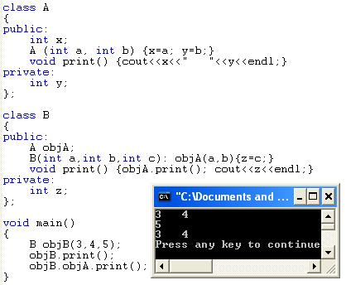
Example
objB
5
z
objA
3
x
4
y
Initialization list goes with the constructor contacting composition in order to pass parameters to the other class constructor.

Slide 17
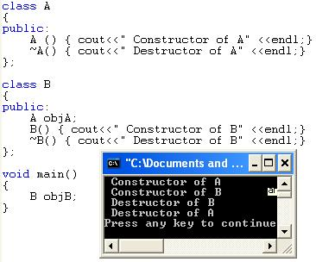
Composition (continued)
Member-objects of a class are constructed
In the order they are declared
Not in the order they are listed in the constructor’s member initialization list
Before the enclosing class objects are constructed

Slide 18
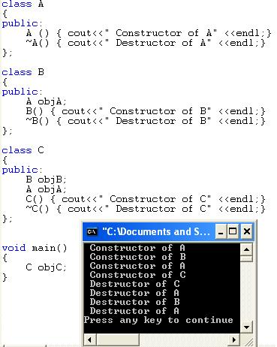
Example
objC
objB
objA
objA

Slide 19
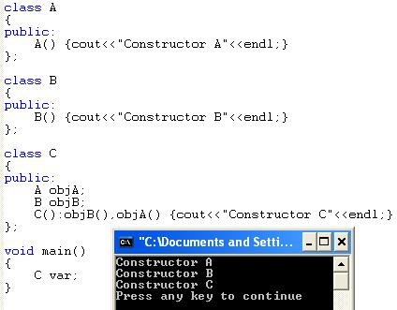
Example

Slide 20
Chapter 6
Inheritance

Slide 21
Chapter 6 Objectives
After completing this module, the student will be able to:
Implement multiple classes with the same interface
Understand the concept of polymorphism
Use polymorphism in real programs
Use virtual functions to define desired interfaces to be fulfilled by objects
Use objects through interfaces instead of concrete implementations
Implement interfaces according to specifications
Compose behaviour of several objects into a single interface implementation
Model real-world entities in C++
Use objects and classes in C++ in a more advanced way
Verify user input
Implement useful and informative data presentation techniques

Slide 22
6.1 Defining class hierarchy

Slide 23
Inheritance
Inheritance is an “is-a” relationship
Example: “every employee is a person”
Inheritance lets us create new classes from existing classes
New classes are called the derived classes
Existing classes are called the base classes
Derived classes inherit the properties of the base classes

Slide 24
Examples
Base class
Student
Shape
Employee
Derived classes
Graduate Student
Undergraduate student
Circle
Rectangle
Faculty Member
Staff member

Slide 25
Inheritance (continued)
Inheritance can be viewed as a tree-like, or hierarchical, structure wherein a base class is shown with its derived classes

Slide 26
Inheritance (continued)
Single inheritance: derived class has a single base class
Ex. Circle class from Shape class
Multiple inheritance: derived class has more than one base class…will not be discussed in this chapter.
Ex. Son class from Mother class and Father class
Public inheritance: all public members of base class are inherited as public members by derived class

Slide 27
6.1.1 Defining a simple subclass (1)
We can use each class as a base (or a foundation) to define or build another class (a subclass). It’s also possible to use more than one class to define a subclass. You can see both of these cases on the right →
Note that the arrows always point to the superclass(es).
The left diagram illustrates a “single inheritance”, and the right one a “multiple inheritance” or “multi-inheritance”.
We’ll show you some examples of both types of inheritance.
We can also write about super classes as base classes, and subclasses as derived classes.

Slide 29
6.1.2 Defining a simple subclass (2)
The class on the right → will serve as a superclass. Analyse its structure – it’s not difficult, we promise.
The program emits the following text:
101

Slide 30
Inheritance (continued)
General syntax of a derived class:
Where memberAccessSpecifier is public, protected, or private (default)
The private members of a base class are private to the base class
Derived class cannot directly access them
Ex. Class SonClass: public FatherClass
{ };

Slide 31
6.1.3 Defining a simple subclass (3)
If we want to define a class named Y as a subclass of a superclass named X, we use the following syntax →
The difference from the notation we used before is in the fact that we have to:
place a colon after the subclass class name
optionally place a so-called visibility specifier (we’ll return to this soon)
add a superclass name
If there’s more than one superclass, we have to enlist them all using commas as separators, like this:
class A : X, Y, Z { … };
Let’s start with the simplest possible case.

Slide 32
6.1.4 Defining a simple subclass (4)
Take a look here → We’ve defined a class named Sub, which is a subclass of a class named Super. We may also say that the Sub class is derived from the Super class.
The Sub class introduces neither new variables nor new functions. Does this mean that any object of the Subclass inherits all the traits of the Super class, being in fact a copy of the Super class’s objects?
No. It doesn’t.

Slide 33
6.1.4 Defining a simple subclass (4) cont’d
If we compile the following code, we’ll get nothing but compilation errors saying that the put and get methods are inaccessible. Why?
When we omit the visibility specifier, the compiler assumes that we’re going to apply a “private inheritance”. This means that all public superclass components turn into private access, and private superclass components won't be accessible at all. It consequently means that you’re not allowed to use the latter inside the subclass.
This is exactly what we want now.

Slide 34
6.1.4 Defining a simple subclass (4) cont’d
We have to tell the compiler that we want to preserve the previously used access policy. We do this by using a “public” visibility specifier:
class Sub : public Super { };
Don’t be misled: this doesn’t mean that the private components of the Superclass (like the storagevariable) will magically turn into public ones. Private components will remain private, public components will remain public.

Slide 35
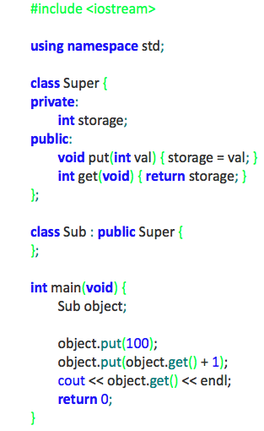
6.1.5 Defining a simple subclass (5)
Objects of the Sub class may do almost the same things as their older siblings created from the Superclass. We use the word ‘almost’ because being a subclass also means that the class has lost access to the private components of the superclass. We cannot write a member function of the Sub class which would be able to directly manipulate the storage variable.

Slide 36
6.1.5 Defining a simple subclass (5) cont’d
This is a very serious restriction. Is there any workaround?
Yes.
There’s the third access level we haven’t mentioned yet. It’s called “protected”.
The keyword protected means that any component marked with it behaves like a public component when used by any of the subclasses and looks like a private component to the rest of the world.
We should add that this is true only for publicly inherited classes (like the Super class in our example previous example)
Let’s make use of the keyword right now.

Slide 37
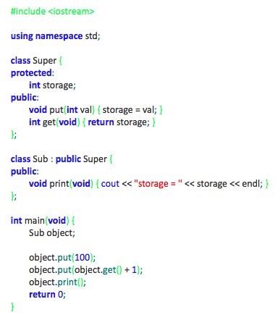
6.1.6 Defining a simple subclass (6)
As you can see in the example code → we’ve added some new functionality to the Sub class.
We’ve added the print function. It isn’t especially sophisticated, but it does one important thing: it accesses the storage variable from the Superclass. This wouldn’t be possible if the variable was declared as private.
In the main function scope, the variable remains hidden anyway. You mustn’t write anything like this:
object.storage = 0;
The compiler will be very stubborn about this.
We almost forgot to mention that our new program will produce the following output:
storage = 101

Slide 38
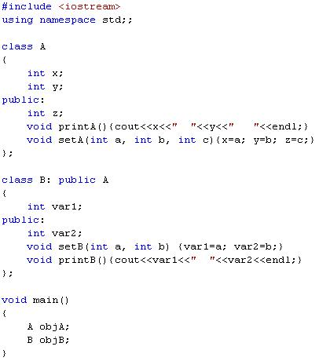
x
objA
Base
y
z
printA
setA
objB
var1
derived
var2
printB
setB
A
x
y
z
printA
setA

Slide 39
x
objA
y
z
printA
setA
objB
var1
Can not access x, y
var2
z
x
y
printB
setB
printA
setA

Slide 40
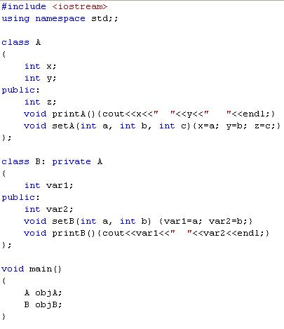
x
objA
y
z
printA
setA
var1
objB
var2
z
x
y
printB
setB
printA
setA

Slide 41
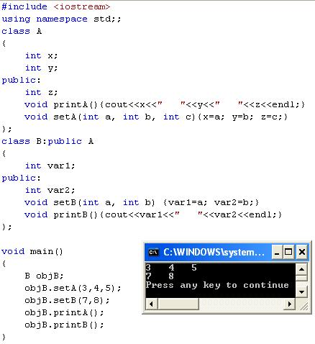
objB
var1
var2
z
x
y
printB
setB
printA
setA

Slide 42
6.1.7 Defining a simple subclass (7)
Now’s a good opportunity to do a little summarising here. We know that any component of the class may be declared as:
public
private
Protected
These three keywords may also be used in a completely different context to specify the visibility inheritance model. So far, we’ve talked about public and private keywords used in such a case. It should be no surprise to you that the protected keyword can be employed in this role, too.

Slide 43
Inheritance (continued)
public members of base class can be inherited as public or private members
The derived class can include additional members--data and/or functions
The derived class can redefine the public member functions of the base class
All members of the base class are also member variables of the derived class

Slide 44
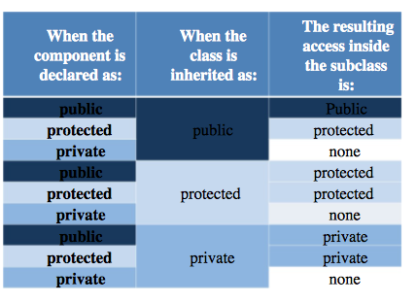
6.1.7 Defining a simple subclass (7) cont’d
Take a look at the table here →
It gathers all of the possible combinations of the component declaration and inheritance model, presenting the resulting access to the components when the subclass is completely defined.
It reads in the following way (take a look at the first row): if a component is declared as public and its class is inherited as public, the resulting access is public.
Familiarize yourself with the table – it’s a basic tool to resolve all the issues regarding the inheritance of the class components.

Slide 45
Redefining (Overriding) Member Functions of the Base Class
To redefine (override) a public member function of a base class
Corresponding function in the derived class must have the same name, number, and types of parameters. Redefined
If the function has a different signature, this would be function overloading.

Slide 46
Redefining (Overriding) Member Functions of the Base Class (continued)
If derived class overrides a public member function of the base class, then to call the base class function, specify:
Name of the base class
Scope resolution operator (::)
Function name with the appropriate parameter list

Slide 47
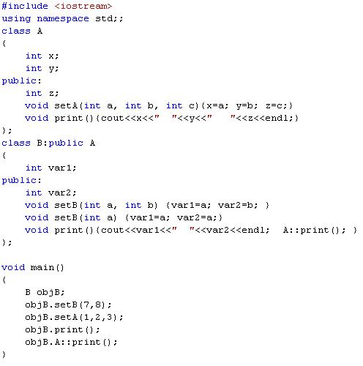
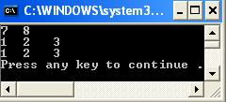
var1
var2
z
x
y
print
setB
A::print
setA

Slide 48
Constructors of Derived and Base Classes
Derived class constructor cannot directly access private members of the base class
Derived class can directly initialize only public member variables of the base class
When a derived object is declared
It must execute one of the base class constructors
Call to base class constructor is specified in heading of derived class constructor definition

Slide 49
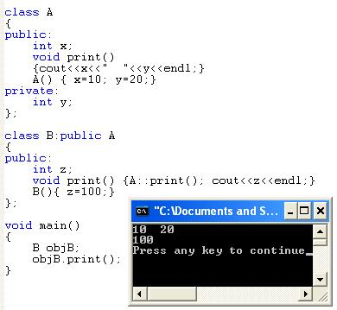
Example

Slide 50
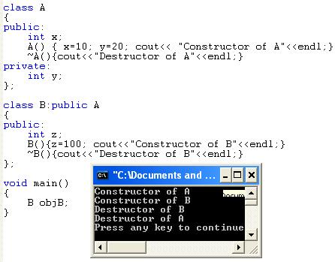
Example

Slide 51
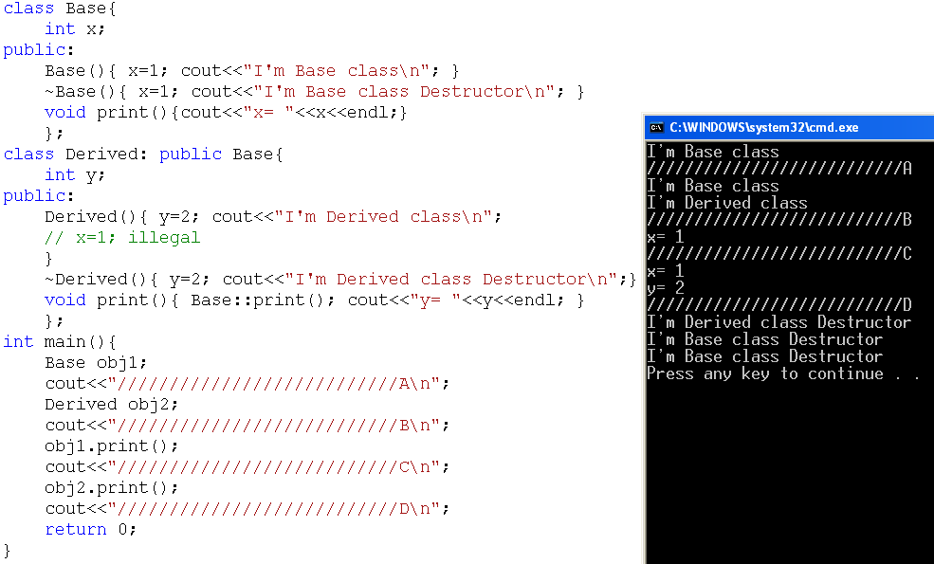
Example
C++ Programming: From Problem Analysis to Program Design, Third Edition
51

Slide 52
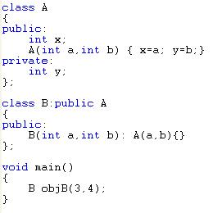
Initialization List and Inheritance
objB
A
3
x
4
y
Initialization list goes with constructor of derived class and uses class name to pass parameters to base class constructor.

Slide 53
Protected Members of a Class
Private members of a class cannot be directly accessed outside the class
For a base class to give derived class access to a private member
Declare that member as protected
The accessibility of a protected member of a class is in between public and private
A derived class can directly access the protected member of the base class

Slide 54
Inheritance as public, protected, or private
If memberAccessSpecifier is public:
public members of A are public members of B and can be directly accessed in class B
protected members of A are protected members of B and can be directly accessed by member functions (and friend functions) of B
private members of A are hidden in B and can be accessed by member functions of B through public or protected members of A

Slide 55
Inheritance as public, protected, or private (continued)
If memberAccessSpecifier is protected:
public members of A are protected members of B and can be accessed by the member functions (and friend functions) of B
protected members of A are protected members of B and can be accessed by the member functions (and friend functions) of B
private members of A are hidden in B and can be accessed by member functions of B through public or protected members of A

Slide 56
Inheritance as public, protected, or private (continued)
If memberAccessSpecifier is private:
public members of A are private members of B and can be accessed by member functions of B
protected members of A are private members of B and can be accessed by member functions (and friend functions) of B
private members of A are hidden in B and can be accessed by member functions of B through public/protected members of A

Slide 57
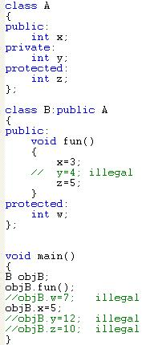
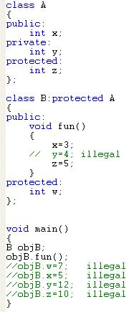
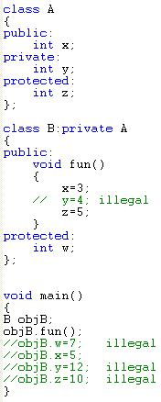

Slide 58
6.1.8 Defining a simple subclass (8)
We’ll finish our current topic with a very simple example demonstrating multi-inheritance. We need to emphasize that using this technique is commonly recognized as error-prone and obfuscating class hierarchy.
Any solution that avoids multi-inheritance is generally better and in fact many contemporary object programming languages don’t offer multi-inheritance at all. We think it’s a good argument to consider when you’re making design assumptions.

Slide 59
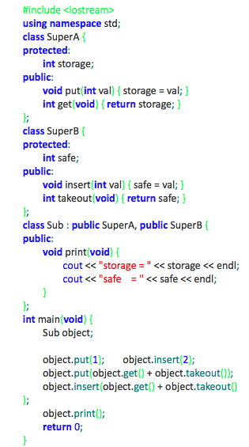
6.1.8 Defining a simple subclass (8) cont’d
This example should be clear (we hope).
The program will produce the following output:
storage = 3
safe = 5

Slide 60
Summary
Inheritance and composition are meaningful ways to relate two or more classes
Inheritance is an “is-a” relation
Single inheritance: a derived class is derived from one class, called the base class
Multiple inheritance: a derived class is derived from more than one base class
Composition is a “has-a” relation

Slide 61
Summary (continued)
Private members of a base class are private to the base class
Public members of a base class can be inherited either as public or private
Derived class can redefine function members of a base class
Redefinition applies only to objects of derived class

Slide 62
Summary (continued)
A call to a base class constructor (with parameters) is specified in the heading of the definition of the derived class constructor
When initializing object of a derived class, the base class constructor is executed first
In composition
Class member is an object of another class
Call to constructor of member objects is specified in heading of the definition of class’s constructor

Slide 63
Summary (continued)
Three basic principles of OOD are:
Encapsulation
Inheritance
Polymorphism
Finding classes:
Describe the problem
Choose classes from the list of nouns
Choose operations from the list of verbs

Slide 64
Examples on composition and inheritence

Slide 65
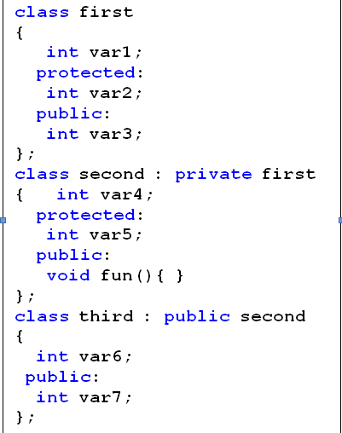
Answer the following questions based on the classes’ definitions shown next.

Slide 66
Output Questions

Slide 67
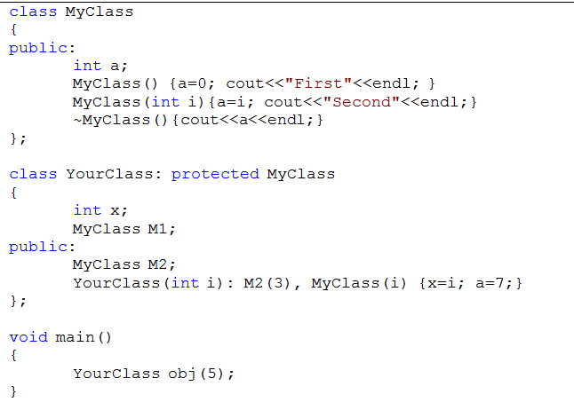
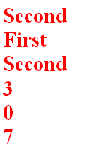

Slide 68
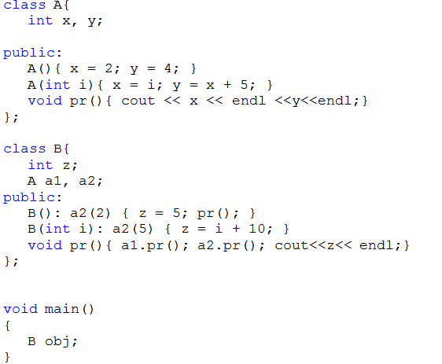


Slide 69
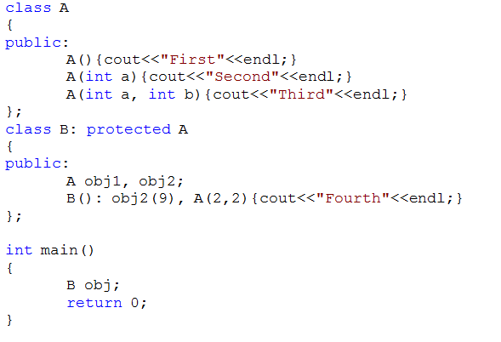


Slide 70
Writing code

Slide 71
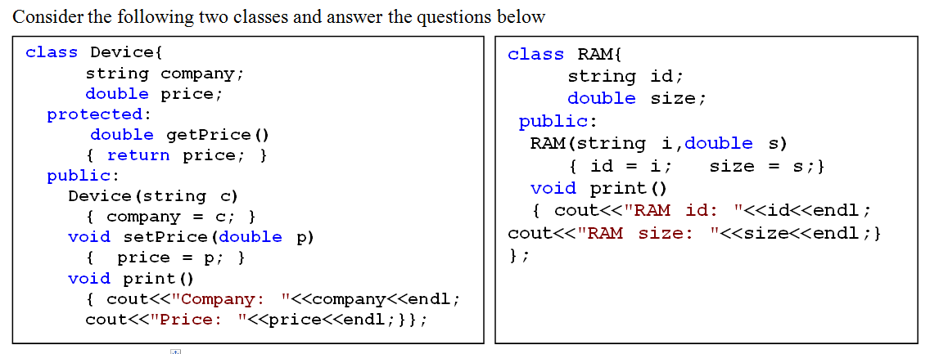

Slide 72
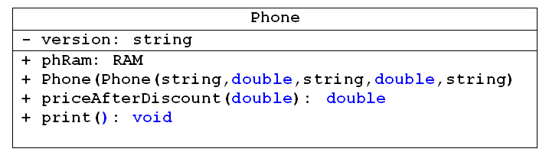
1) Write the header (the definition) of the new class Phone which publically inherits the properties of the class Device with the following additional members as shown in the above UML class diagram. (Don't write the implementation of the member functions inside the header)

Slide 73
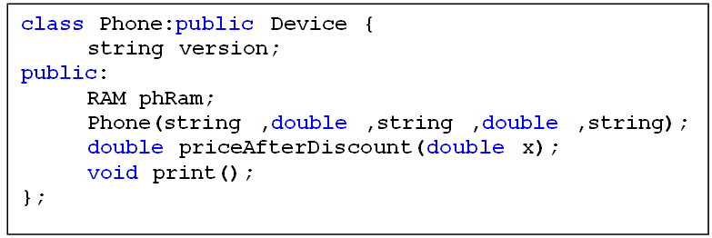

Slide 74
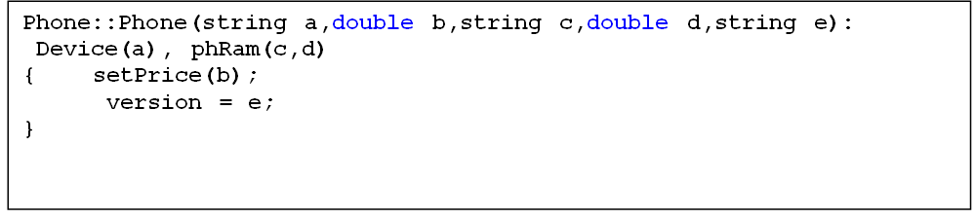
2) Write the implementation of the Constructor function (outside the class) that takes five parameters to set the company and the price for the Device, the id and the size for the phRam and the version for the Phone.

Slide 75
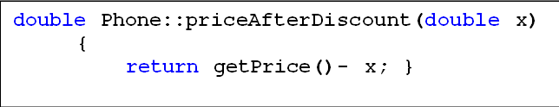
3) Write the implementation of priceAfterDiscount function that receives one double value which represents the discount for the phone and return the price after the discount.

Slide 76
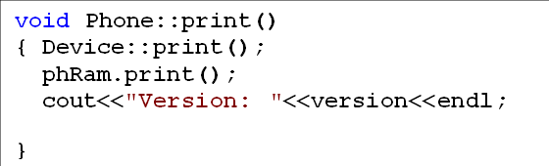
4) Write the implementation of the print function (outside the class) to print the company and the price for the Device, the id and the size for the phRam and the version for the Phone.

Slide 77
6.2 Classes, inheritance and type compatibility

Slide 78
You can pass an object of a derived class to a formal parameter of the base class type

Slide 80
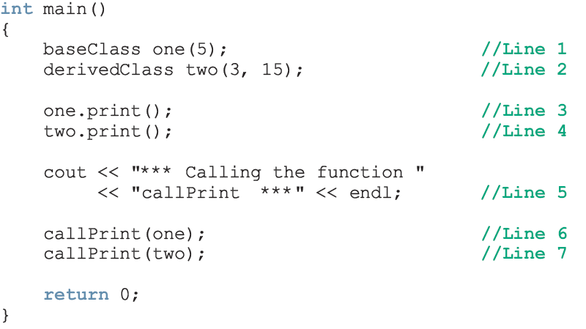
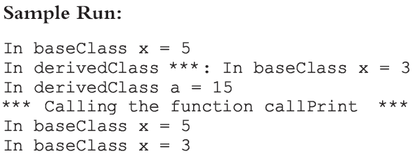

Slide 81
For both statements (Lines 6 and 7), member function print of baseClass was executed
Because the binding of print, in the body of callPrint, occurred at compile time
Compile-time binding: the necessary code to call a specific function is generated by the compiler
Also known as static binding

Slide 82
How can we avoid this problem?
Virtual functions (reserved word virtual)
Virtual function: binding occurs at program execution time, not at compile time
This kind of binding is called run-time binding
Run-time binding: compiler does not generate code to call a specific function; it generates information to enable run-time system to generate specific code for the function call
Also known as dynamic binding

Slide 83
Inheritance, Pointers, and Virtual Functions (continued)

Slide 84
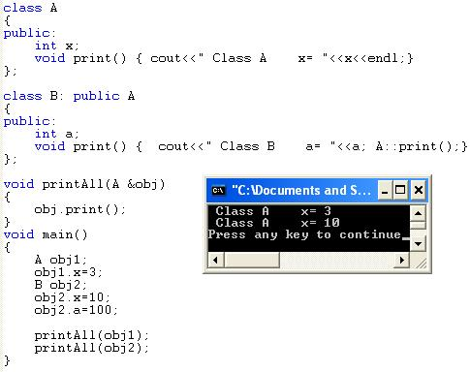
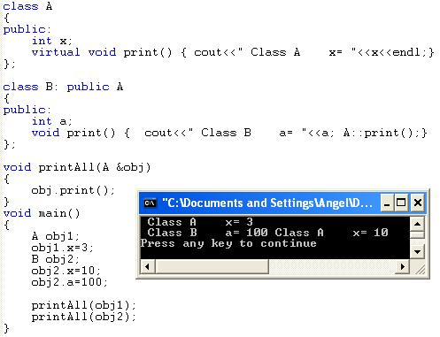

Slide 85
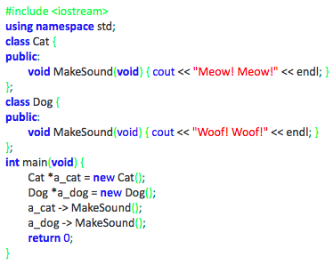
6.2.1 Type compatibility – the simplest case
Each new class constitutes a new type of data. Each object constructed on the basis of such a class is like a value of the new type.
This means that any two objects may (or may not) be compatible in the sense of their types.
Take a look at the very simple example on the right →

Slide 86
6.2.1 Type compatibility – the simplest case cont’d
The objects of the Cat class are not compatible with the objects of the Dog class, although the structure of both classes is identical. Neither of the following assignments is valid and both of them will cause a compiler error:
a_dog = a_cat;
a_cat = a_dog;
As you see, the Dog and Cat classes have nothing in common in the sense of inheritance – they’re both completely independent.
So we can say that objects derived from classes which lie in different branches of the inheritance tree are always incompatible.
The program will produce the following output:
Meow! Meow!
Woof! Woof

Slide 87
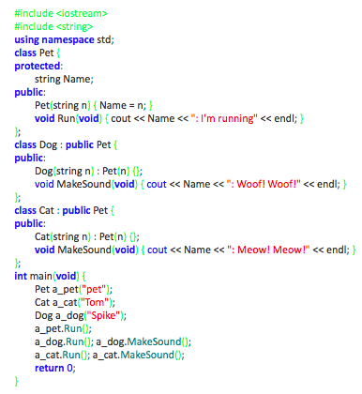
6.2.2 Type compatibility – more complex case (1)
We’ve rebuilt our example significantly. We still have the two previous classes Dog and Cat, but we’ve put them into the same inheritance tree. Take a look →

Slide 88
6.2.2 Type compatibility – more complex case (1) cont’d
objects of the superclass are compatible with objects of the subclass
objects of the subclass are not compatible with objects of the superclass
This means that:
you can do the following:
a_pet = new Dog("Huckleberry");
a_pet -> Run();

Slide 89
6.2.2 Type compatibility – more complex case (1) cont’d
but you cannot do anything like this:
a_pet -> MakeSound();
because Pets don’t know how to make sounds (in our world of classes, at least)
you are not allowed to do the following:
a_dog = new Pet("Strange pet");

Slide 90
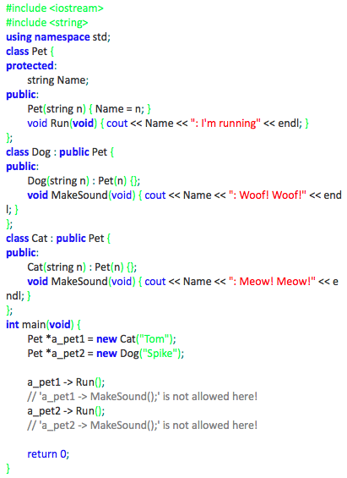
6.2.3 Type compatibility – more complex case (2)
The sample code here →
illustrates the rules we’ve just described.
Analyze the code and pay attention to how the pointer to the superclass objects (a pointer of type Pet *) may serve as a pointer to subclass objects.
The comments mark the statements that would be illegal in this context.
The code produces the following output:
Tom: I'm running
Spike: I'm running

Slide 91
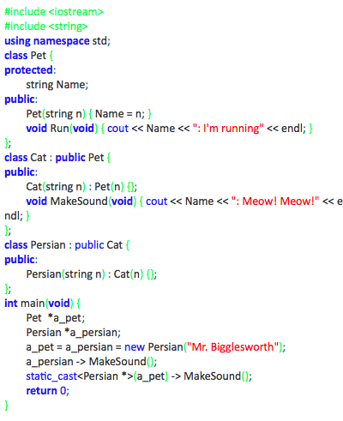
6.2.7 Type compatibility – final case
The rule stating that objects lying at higher levels are compatible with objects at lower levels of the class hierarchy works even when the inheritance chain is arbitrarily long.
The example here → shows a chain of three classes. The pointer to the top-most superclass works perfectly for the bottom-most objects too.
The program emits the following text:
Mr. Bigglesworth: Meow! Meow!
Mr. Bigglesworth: Meow! Meow!

Slide 92
6.3 Polymorphism and virtual methods

Slide 93
6.3.1 Overriding a method in the subclass (1)
When a subclass declares a method of the name previously known in its superclass, the original method is overridden. This means that the subclass hides the previous meaning of the method identifier and any invocation encoded within the subclass will refer to the newer method.

Slide 95
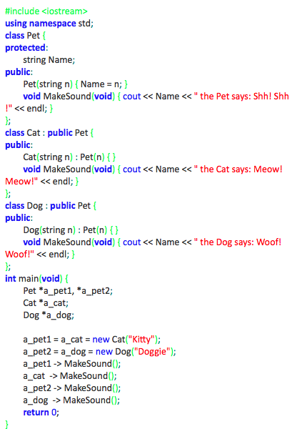
6.3.2 Overriding a method in the subclass (2)

Slide 96
6.3.3 Overriding a method in the subclass (3)
We want to ask you now for your full attention as we are going to introduce one of the most important objective notions: polymorphism. This is a method to redefine the behaviour of a superclass (but only the one that explicitly agrees to be treated in this way!) without touching its implementation.

Slide 97
6.3.3 Overriding a method in the subclass (3) cont’d
The word “polymorphism” means that the one and same class may show many (“poly” – like in “polygamy”) forms (“morphs”) not defined by the class itself, but by its subclasses.
Another definition says that polymorphism is the ability to realize class behaviour in multiple ways. Both definitions are ambiguous and could not actually be used to explain the true nature of the phenomenon. We believe that an example will work better.

Slide 98
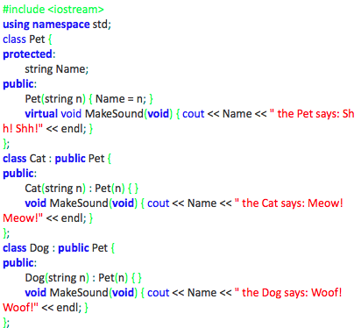
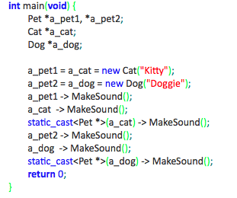
6.3.3 Overriding a method in the subclass (3) cont’d
Take a look at the code below. It’s almost the same as the previous one. The main function may look different but the class definitions are nearly identical. There’s only one difference – one keyword has been added to the code. Can you find it?

Slide 99
6.3.3 Overriding a method in the subclass (3) cont’d
Yes, you’re right – it’s the word “virtual”, placed in front of the MakeSound member function, inside the Pet class body.
This word means that the method won’t be overridden within any of the possible subclasses. It also means that the method will be redefined(replaced) at the level of the original class.
To make a long story short – the example program will output a somewhat surprising piece of text. This is how it goes:
Kitty the Cat says: Meow! Meow!
Kitty the Cat says: Meow! Meow!
Kitty the Cat says: Meow! Meow!
Doggie the Dog says: Woof! Woof!
Doggie the Dog says: Woof! Woof!
Doggie the Dog says: Woof! Woof!

Slide 100
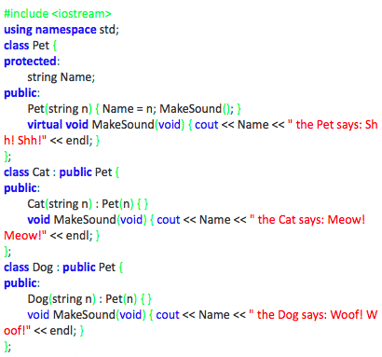
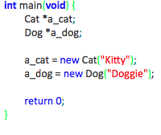
6.3.4 Overriding a method in the subclass (4)
The next example shows that the binding between the origin of the virtual function (inside the superclass) and its replacement (defined within the subclass) is created dynamically, during the execution of the program.
Take a look at the example →

Slide 101
6.3.4 Overriding a method in the subclass (4)
We invoke the MakeSound method as part of the Pet constructor. We already know that the method is polymorphically replaced by the new implementations presented by the Cat and Dog subclasses. We don’t know yet when the replacement occurs.
The program will output the following lines:
Kitty the Pet says: Shh! Shh!
Doggie the Pet says: Shh! Shh!
This means that the binding between the original functions and their polymorphic implementations is established when the subclass object is created, not sooner.

Slide 102
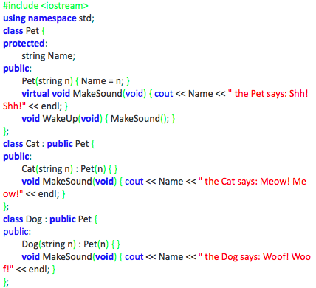
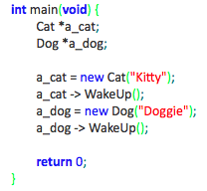
6.3.5 Overriding a method in the subclass (5)
Overriding a method in the subclass – continued
The experiment we’re going to perform using our software guinea pig refers to the fact that the virtual method may be invoked not only from outside the class but also from within.
Check out this example, please →

Slide 103
Classes and Virtual Destructors
Classes with pointer member variables should have the destructor
Destructor can be designed to deallocate storage for dynamic objects
If a derived class object is passed to a formal parameter of the base class type, destructor of the base class executes
Regardless of whether object is passed by reference or by value
Solution: use a virtual destructor (base class)

Slide 104
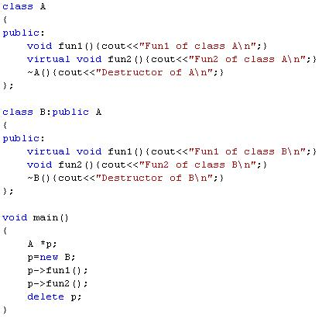
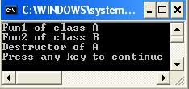

Slide 105
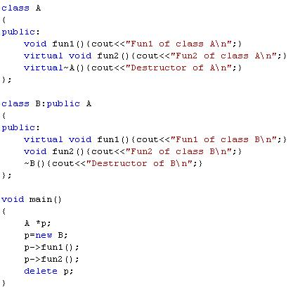
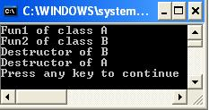

Slide 106


Virtual functions for class A:
fun2
Virtual functions for class B:
fun1 and fun2
Virtual functions for class C:
fun1 and fun2 and fun3

Slide 107
Classes and Virtual Destructors (continued)
The virtual destructor of a base class automatically makes the destructor of a derived class virtual
After executing the destructor of the derived class, the destructor of the base class executes
If a base class contains virtual functions, make the destructor of the base class virtual

Slide 108


Slide 109
Abstract Classes and Pure Virtual Functions
Through inheritance, we can derive new classes without designing them from scratch
Derived classes inherit existing members of base class, can add their own members, and also redefine or override public and protected member functions
Base class can contain functions that you would want each derived class to implement
Base class may contain functions that may not have meaningful definitions in the base class

Slide 110
Abstract Classes and Pure Virtual Functions (continued)
To make them pure virtual functions:

Slide 111

A
B
C
Y
Z

Slide 112

Virtual functions
Class A is Abstract class
Class B is non abstract class

Slide 113
Abstract Classes and Pure Virtual Functions (continued)
Abstract class: contains one or more pure virtual functions
You cannot create objects of an abstract class

Slide 114
Abstract Classes and Pure Virtual Functions (continued)
If we derive rectangle from shape, and want to make it a nonabstract class:
We must provide the definitions of the pure virtual functions of its base class
Note that an abstract class can contain instance variables, constructors, and functions that are not pure virtual
The class must provide the definitions of constructor/functions that are not pure virtual

Slide 115



Slide 116
Compositions vs. constructors

Slide 117
6.5.10 Compositions vs. constructors (1)
Inheritance isn’t the only form of class/object coexistence. In fact, inheritance is completely useless when we express many of the complicated relationships existing in the real world.
For example, we can imagine a class designed to gather different kinds of dogs. Making a class and putting it at the bottom of a dog breed inheritance tree isn’t a good idea and won’t bear desirable fruit. The right solution will come to our minds when we understand the actual role of the class – it should gather some dogs so, in fact, it will consist of dogs (like a kennel).

Slide 118
6.5.10 Compositions vs. constructors (1) cont’d
This means that the class should include dogs, not inherit them. The kennel has nothing or really very little in common with a dog (for example, there is no kennel that can bark).
We can say that any complex structure is composed using simpler elements – for example, a car is composed of an engine, transmission, suspension, etc. If we imagine all these parts as classes we’ll see the car class as a composition that has nothing to do with inheritance.
As you’ve probably guessed, building a class is called composition.

Slide 119

6.5.10 Compositions vs. constructors (1) cont’d
Take a look at the example on the right →
This example shows a simple dummy class consisting (composed) of two objects of two independent classes.
You won’t have any trouble seeing that the program produces the following output:
A is doing something
B is doing something

Slide 120


6.5.11 Compositions vs. constructors (2)
The example on the right → shows the same composed class although its components have been modified. We’ve equipped them with copying constructors – can you see them? They aren’t all that complex and they don’t actually do anything useful. They only emit a message allowing us to notice that the constructor has been invoked.

Slide 121
6.5.11 Compositions vs. constructors (2) cont’d
We’ve had to add default constructors too – why? You should know the answer now.
The Compo class doesn’t have a copying constructor. This means that the compiler will generate an implicit copying constructor for the class. As far as we know, this constructor copies the objects bit by bit. Now we’re about to discover another interesting feature of the constructor.
We’ve compiled the code and run it. It’s produced the following output:
copying A...
copying B...
A is doing something
B is doing something

Slide 122
6.5.11 Compositions vs. constructors (2) cont’d
This means that, besides its normal activity (the cloning), the copying constructor takes into consideration all the existing copying constructors (implicit and explicit) defined within the objects used to compose the class. This gives a chance to copy the components in the most appropriate way.
Now we’re going to do another experiment.

Slide 123


6.5.12 Compositions vs. constructors (3)
We’ve modified the Compo class – you can find it here → It now has its own copying constructor. It’ll be implicitly invoked once during the life of our program at the moment the co2 object is created.

Slide 124
6.5.12 Compositions vs. constructors (3) cont’d
The program produces the following output:
Copying Compo...
A is doing something
B is doing something
Does this surprise you? The explicit copying constructor (written by us) has invoked none of the component’s copying constructors. Unfortunately, defining your own copying constructor means you assume full responsibility for all the activities needed to carry out responsible copying. This means that we need to modify the constructor.

Slide 125
6.5.12 Compositions vs. constructors (3) cont’d
One way to do this is to add a line like this one:
Compo(Compo &src) : f1(src.f1), f2(src.f2) { cout << "Copying Compo..." << endl; }
instead of
Compo(Compo &src) { cout << "Copying Compo..." << endl; }

Slide 126
6.5.12 Compositions vs. constructors (3) cont’d
The solution is correct despite how it looks. The modified program behaves the way we want, producing the following output:
copying A...
copying B...
Copying Compo...
A is doing something
B is doing something

